Slide 1
WingTipTickets
Azure SQL Database & Azure Search HOL V2.1

Slide 2
WTT Architecture
Region A
Traffic Manager
Region A
Primary
Azure WebApp
Primary Customer Database
Tables:
Concerts
Customers
Tickets
Venues etc
Geographic Replication
Region A
Secondary
Azure WebApp
Secondary Customer Database
Tables:
Concerts
Customers
Tickets
Venues etc
Region B

Slide 3
Demo scenarios and pre-reqs
Feature | Story | How
 | Connect via SSMS to verify DBs
Ticket purchase | Show that sample application | Navigate to http://gh01julieandtheplantes.trafficmanager.net/
Vertical Scaling | Anticipation of a big name artist in a specific city | Portal: change service-tier or performance level
Horizontal Scaling (Elastic & Geo scale) | Anticipation of a big name artist country wide with sale on same day | Portal: show shards (databases) ( VS: show multi-shard query and associated sharp map (cities) and data dependent route (city)
Auditing | Key Arena DB mysteriously vanished | Portal: show the operation to enable and setup Auditing for a specific DB; auditing dashboard VS: show security-enabled connection string, and change the password Portal: Delete the Venue DB Web site: show missing Key Arena venue Excel: show dashboard – show who deleted the DB
Point-in-time restore | Accidental DB deletion | Portal: restore a point in time backup Web site: show there’s still an error after restoring the Venue DB because of the incorrect password Excel: show dashboard – show the spike in login failures because of incorrect password VS: correct the password Web site: show that all is working with the restored Venue DB
Geographic disaster recovery | Server in a datacenter goes down | Portal: increase the size of the DB instance from S to P1 (since active-geo is only available in P instances) Portal: show how traffic manager is setup to redirect traffic to a hot standby of the web tier Portal: shutdown the primary web tier VM Portal: show how a geo replicated secondary can make available a hot standby of the data tier Portal: stop replication to the secondary, which effectively promotes to secondary to a primary Web site: show how the site continues to run without interruption
Predictable performance across service tiers and performance levels | Am I using the right service/performance tier (SKU) based on my usage? | SSMS: show the dynamic management view, which uses historical consumption data to recommend the right service tier/performance level
Workload insights | What if I want an automated way to assess my historical usage and recommend DB size, SKU size, expected usage etc? | Portal: From Workload Insights, show how a poor performing Index has been identified and hints appear to recommended index optimization.
An Azure account
If you don’t already have an Azure Account, browse to http://azure.microsoft.com/en-us/pricing/free-trial/
Installation of Visual Studio
If you don’t already have Visual Studio installed
Installation of ‘Microsoft Azure Powershell’ and Azure SDK
Browse to http://azure.microsoft.com/en-us/downloads/
Under Command-line Tools, Windows PowerShell, select Install
Under SDKs, .NET, select the VS specific installation based on your version of Visual Studio
Deployment Scripts & load generator
Demo script & deployment guide

Slide 4
HOL Key Steps summary
Download and unzip WTTHOL2.1.zip to a local folder e.g. c:\
https://github.com/guyhay/WTT-Demo-Hol
Launch Azure PowerShell (as an administrator)
Add-AzureAccount
Select-AzureSubscription –SubscriptionId <provide your subscription that you want to use>
Set-ExecutionPolicy -Scope LocalMachine -ExecutionPolicy Unrestricted –Force
Switch to the directory where you unzipped scripts.zip e.g. c:\scripts
Unblock-file .\New-WTTEnvironment.ps1
. .\New-WTTEnvironment.ps1
New-WTTEnvironment -WTTEnvironmentApplicationName xx00julieandtheplantes

Slide 5
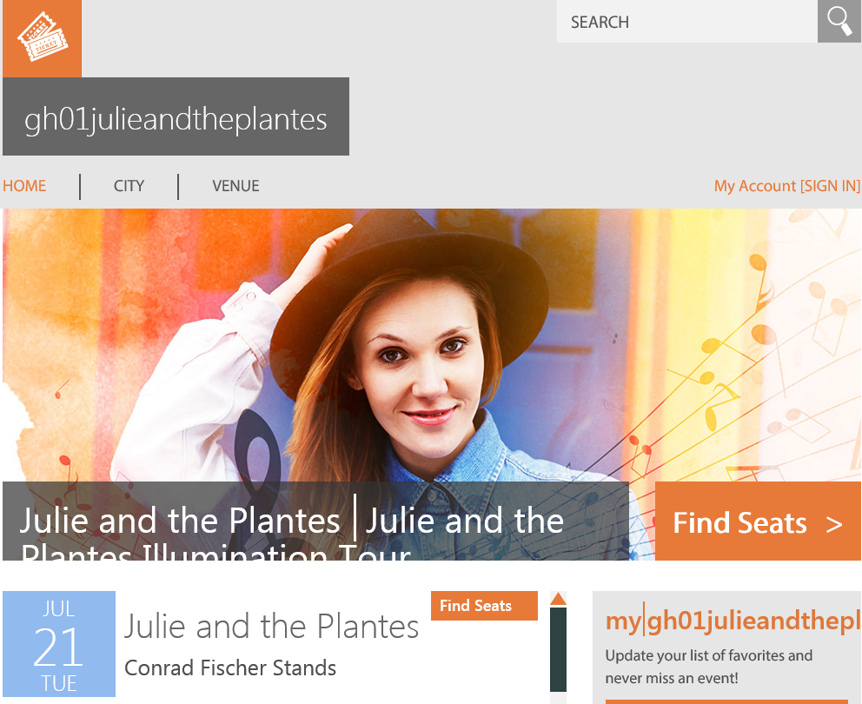
http://gh01julieandtheplantes.trafficmanager.net/

